Slide 1
Graphs of Exponential Functions

Slide 2
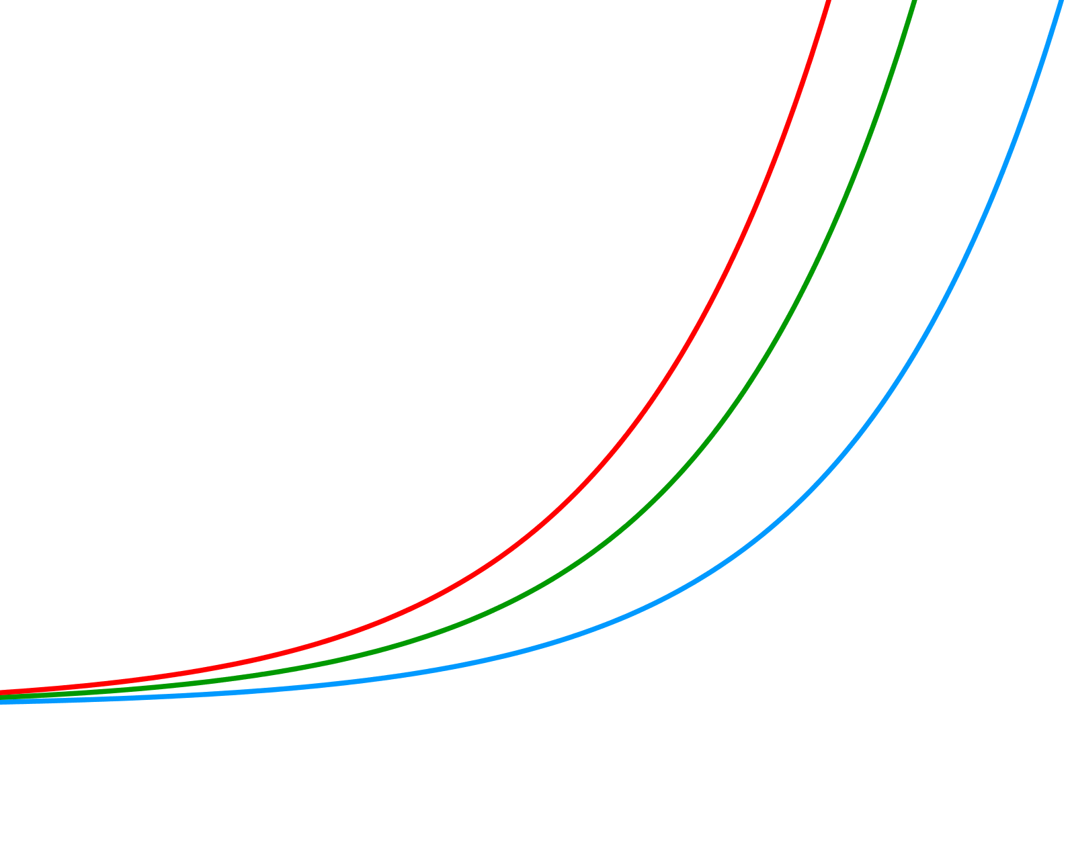



We have already discussed the graph of exponential functions in lesson 3.1.
In this lesson, we will discuss the effect of a and b in the equation y = ab^{x}.
Effect of the parameter a
The figure below shows the graphs of y = 5(1.03)^{x}, y = 10(1.03)^{x}, and y = 15(1.03)^{x}.
y
15
10
5
x
o
The parameter a represents the value of the function when x = 0. It also represents
the y-intercept of the function.

Slide 3
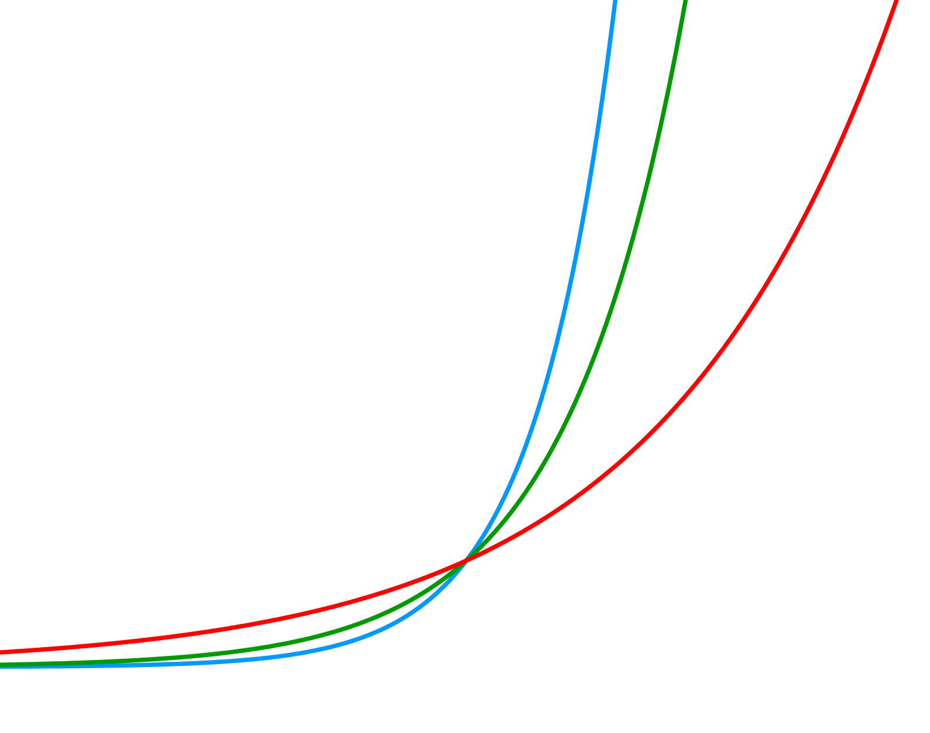
Effect of the parameter b > 1
The figure below shows the graphs of y = 5(1.04)^{x}, y = 5(1.08)^{x}, and y = 5(1.12)^{x}.
y
y = 5(1.12)^{x}
y = 5(1.08)^{x}
y = 5(1.04)^{x}
10
x
o
The parameter b is the growth factor of the function. If b > 1, the figure above
shows that the greater the value of b, the faster the graph grows.

Slide 4
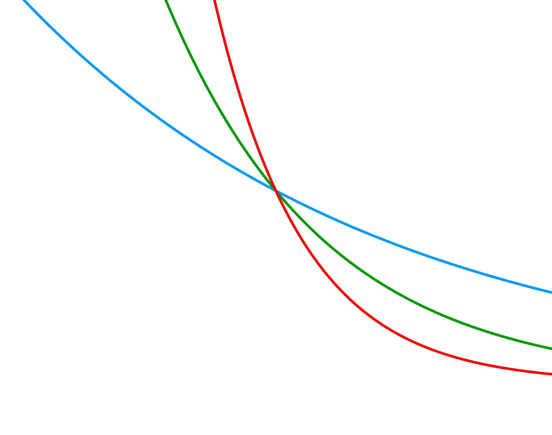
Effect of the parameter 0 < b < 1
The figure below shows the graphs of y = 5(0.8)^{x}, y = 5(0.6)^{x}, and y = 5(0.4)^{x}.
y
5
y = 5(0.8)^{x}
y = 5(0.6)^{x}
o
x
y = 5(0.4)^{x}
The parameter b is the decay factor of the function. If 0 < b < 1, the figure above
shows that the smaller the value of b, the faster the graph decays.

Slide 5
The graph of an exponential function can be useful when solving
exponential equations
Example 1
Solve the equation 3(1.15)^{x} = 8
Solution
The equation 3(1.15)^{x} = 8 cannot be solved by algebraic methods that have
been taught in past lessons. It can be solved exactly by using logarithms (that
will be discussed in chapter 4.)
In the meantime, we can also solve the equation graphically and obtain an
approximate answer.

Slide 6
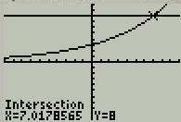
By using a graphing calculator, we can obtain the following sketch of functions
y1 = 3(1.15)^{x} and y2 = 8 below.
The point of intersection was found by using the process explained in Example 6,
class notes from lesson 3.1.
From the graph, we find that both functions have y = 8 when x ≈ 7.018.
Check: 3(1.15)^{7.018} = 8.00016047 Good enough!!
Then, x = 7.018
Answer

Slide 7
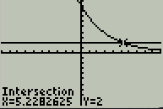
Example 2
Solve the equation 9(0.75)^{x} = 2
Solution
By using a graphing calculator, we can obtain the following sketch of
functions y1 = 9(0.75)^{x} and y2 = 2 below.
The point of intersection was found by using the process explained in Example 6,
class notes from lesson 3.1.
From the graph, we find that both functions have y = 2 when x ≈ 5.228.
Check: 9(0.75)^{5.228} = 2.00015105 Good enough!!
Then, x = 5.228
Answer

Slide 8
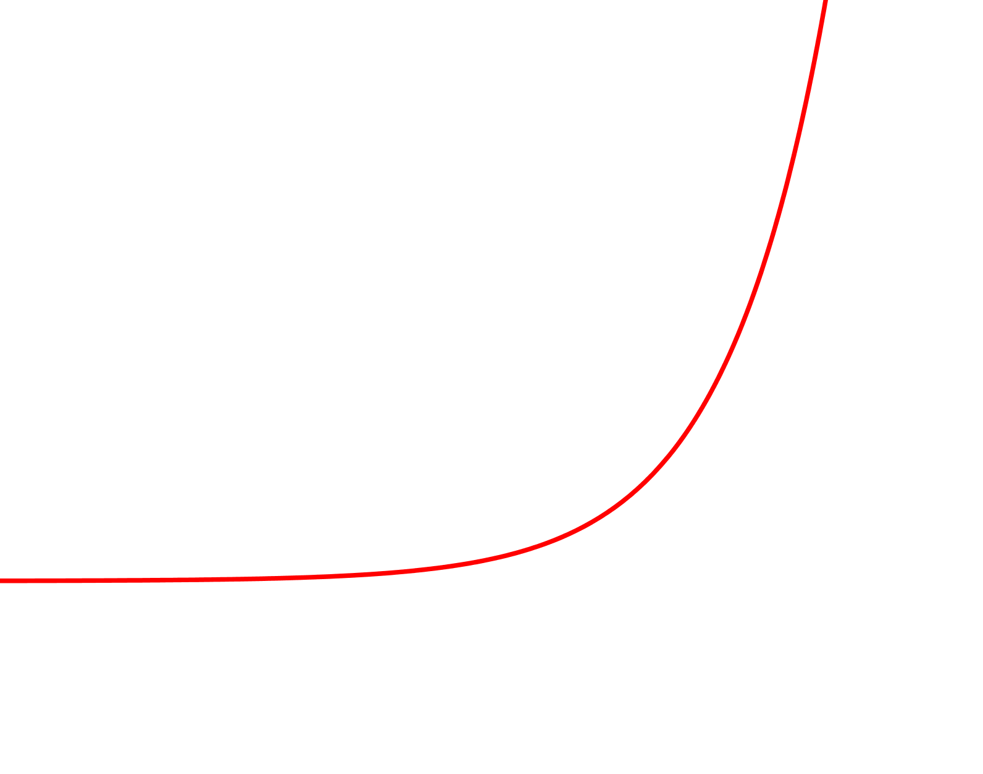
Sometimes, data obtained from an experiment approximates an exponential function.
The figure below shows that case.
y
o
x
All data points (in black) do not fit exactly in the exponential function (in red) but it
looks like the red curve is one that could be used to represent all points.
If we ask several people to draw a curve to represent the given points, each person
would draw a graph different from the others but all of the graphs would be very
close to the curve that best fit the given points.
Finding the exponential function that best fit some given data is known as
exponential regression. The next example includes instructions to obtain it.

Slide 9
Example 3
Find the exponential function that best fit the data in the table below.
x | 0 | 2 | 4 | 6 | 8
y | 45 | 89 | 364 | 717 | 1445
Solution
On TI-83 calculator:
1) Press button, in third row. Rows are counted from top to bottom.
STAT
2) On the screen EDIT CALC TESTS, option 1: Edit is selected by default.
ENTER
3) Press button, in bottom row.
4) Calculator is showing columns L1, L2, and L3. If you have data below L1,
or L2, you may delete them by placing the cursor on each entry and pressing
the key in 2nd row.
DEL

Slide 10
5) Once all data below L1 and L2 have been deleted, you may type the data
corresponding to x (from your table) in column L1.
Put the cursor under L1 and type 0. Then, press .
ENTER
The cursor moved to 2nd line. Type 2. Then, press .
ENTER
The cursor moved to 3rd line. Type 4. Then, press .
ENTER
The cursor moved to 4th line. Type 6. Then, press .
ENTER
The cursor moved to 5th line. Type 8. Then, press .
ENTER
6) Now, press the right arrow  button, from the set of arrow buttons at the
right side of calculator.
7) The cursor moved to the first line under L2. Type 45 and press .
ENTER
The cursor moved to 2nd line. Type 89. Then, press .
ENTER
The cursor moved to 3rd line. Type 364. Then, press .
ENTER
The cursor moved to 4th line. Type 717. Then, press .
ENTER
The cursor moved to 5th line. Type 1445. Then, press .
ENTER

Slide 11
8) Now that all data is in, type again.
STAT
9) Press .
10) The cursor is on CALC. Scroll down to command 0: ExpReg.
11) Press . The command ExpReg has been copied onto the screen.
ENTER
12) To tell the calculator the column where your x data is, press the orange button
2nd in second row. Now, press the 1 key, in the second to last row.
13) The label L₁ has been copied onto the screen.
14) Press the comma key , in the fifth row.
15) To tell the calculator the column where your y data is, press the orange button
2nd in second row. Now, press the 2 key, in the second to last row.
16) The label L₂ has been copied onto the screen.

Slide 12
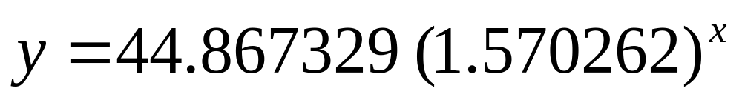
17) Now that the calculator has all the information it needs to perform the
exponential regression, press .
ENTER
18) The following appears on the screen.
y=a*b^x
a=44.8673292
b=1.570261529
Other results might appear below b = 1.570261529. We will not use
those results at this time.
19) Thus, after assembling the equation by using the values a and b, we obtain:
20) The equation above is the one that best fits the data from your table.

Slide 13
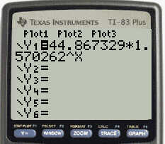
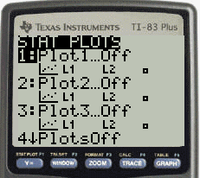
To show how well the curve fits the given data, do the following.
Y =
21) Press the key (second row) and type
44.867329*1.570262^X after y1 = to obtain
22) Press in second row and in
first row to obtain
2nd
Y =

Slide 14
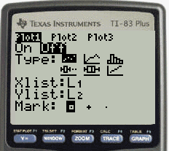
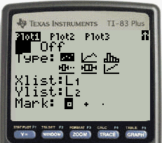
23) The cursor is in Plot 1 by default.
Press to open Plot 1 and obtain
ENTER
24) The cursor is blinking on On by default.
Press to turn Plot1 on and
to obtain
ENTER

Slide 15
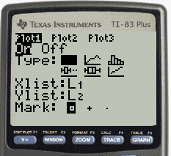
25) Press  to move the cursor one row down
to the icon (scatter graph mode)
ENTER
Press to obtain
26) Press  to move the cursor one row down
to the Xlist: line.
To tell the calculator that your x-values are
on list L1, press and then press
to obtain
2nd
1

Slide 16
27) Press  to move the cursor one row down
to the Ylist: line.
To tell the calculator that your y-values are
on list L2, press and then press
to obtain
2nd
2
28) Press  to move the cursor one row down
to the Mark: line.
Put the cursor on the ▪ symbol and press
to obtain (points from the data will
be represented by ▪ in the graph.)
ENTER

Slide 17
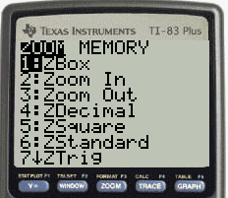
29) Plot1 is On now and ready to produce a graph in scatter mode, by using
x-values from the L1 list, by using y-values from the L2 list, and by drawing
dots represented by ▪.
Press to obtain
ZOOM

Slide 18
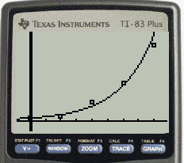
30) Scroll down to 9: ZoomStat and press
to obtain.
ENTER
We can see that the function Y = 44.867329*1.570262^X fits the data
x | 0 | 2 | 4 | 6 | 8
y | 45 | 89 | 364 | 717 | 1445
very well!

Slide 19
The End

